Slide 1
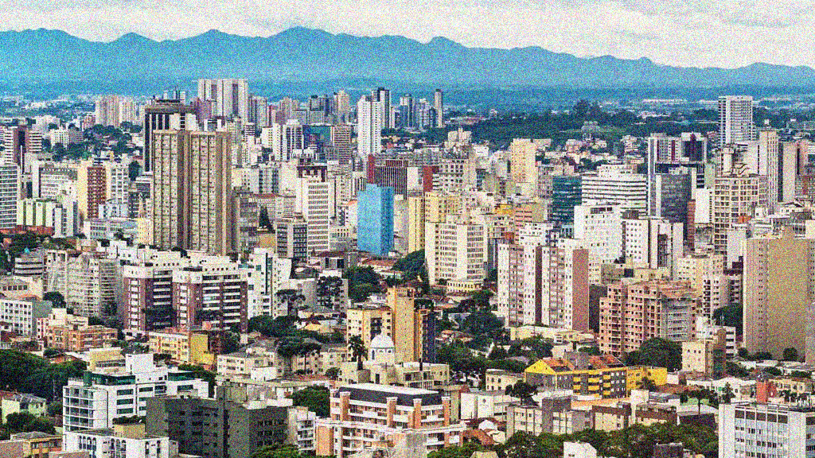
BUS RAPID TRANSIT: CURITIBA, BRAZIL
Luis Antonio Lindau, Dario Hidalgo, Daniela Facchini
READING PRESENTATION: TEDDY KIM

Slide 2
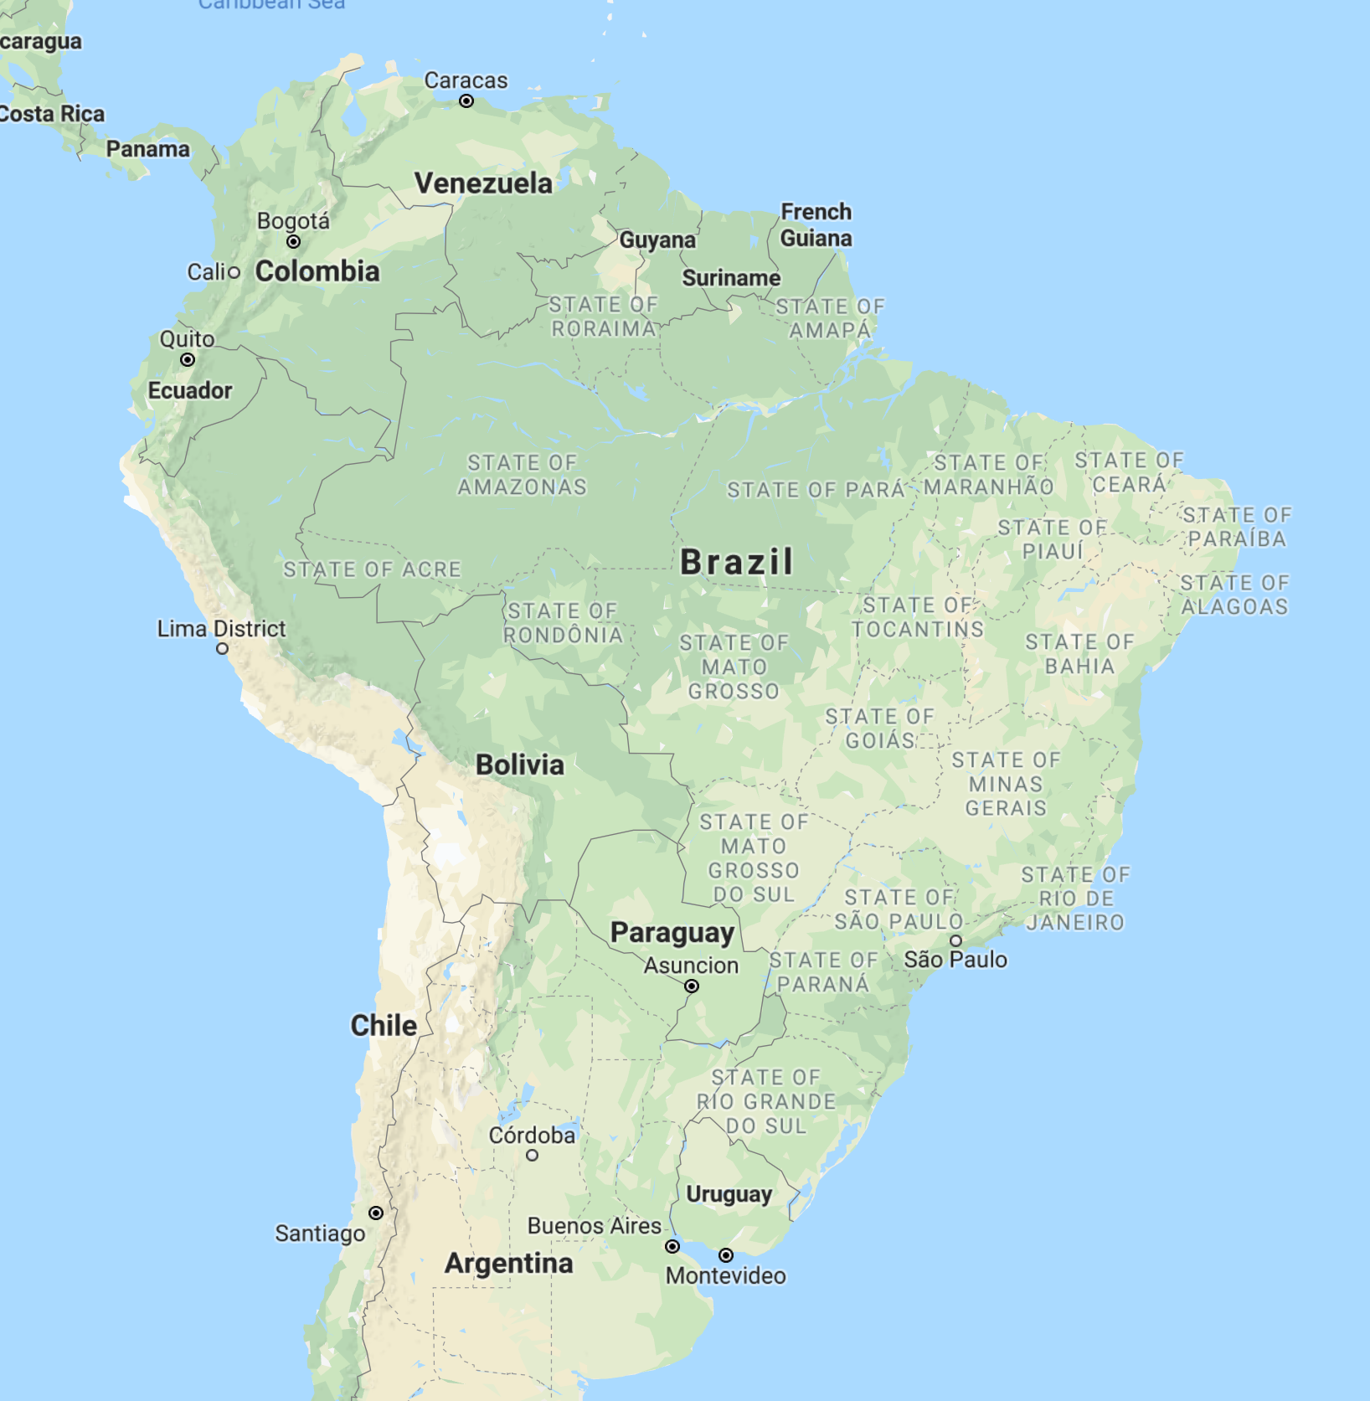

Parana State, Brazil
POPULATION:
1.87 million (7th largest in Brazil)
GDP (per capita): $33,214 ($8,600)

Slide 3
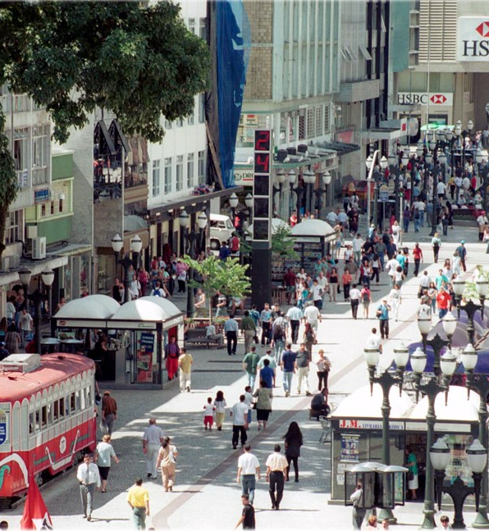
CURITIBA, BRAZIL
4.6% annual growth every year for last decade
40% car ownership (highest in Brazil)
Utilized federal transportation aids to improve not only infrastructure, but urban development

Slide 4
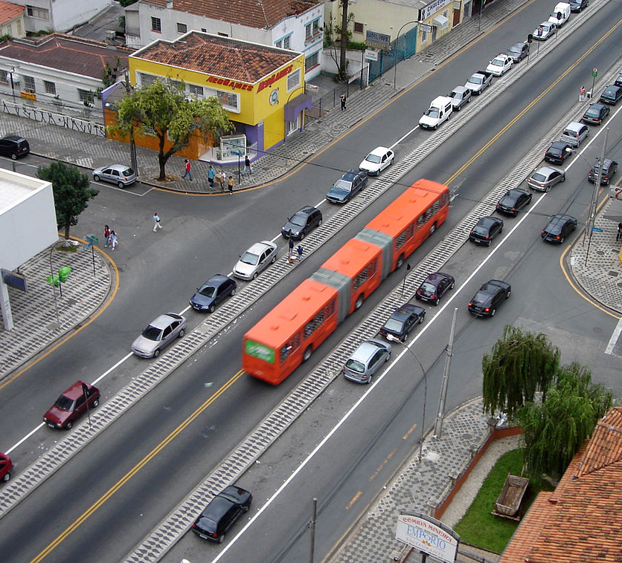
BRT AT A GLANCE
2,200 buses (1 bus per 850 people), compared to NYC 4,300 buses (1 bus per 1,900 people)
99% schedule adherence
2.26 million riders per day
Average speed of 17.5 kph (13 kph in NYC)

Slide 5
1970
1980
Originally planned a Light Rail System
Settled on trunk and feeder bus system with dedicated travel lanes (busways)
Prepayment system at sheltered stations
Biarticulated buses with multiple doors
1990
PRESENT
Urban Development Agency of Curitiba (URBS) given full authority over all transit modes in the city
Curitiba is considered to have one of the most sustainable transportation systems in the world

Slide 6
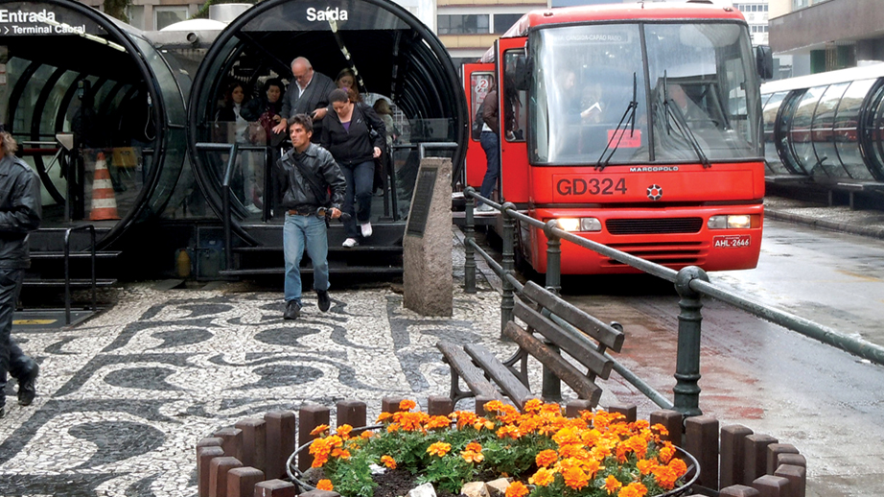
Curitiba’s Success:
SYSTEM ORGANIZATION
TRANSIT CORRIDORS
TRANSIT INFRASTRUCTURE

Slide 7
SYSTEM ORGANIZATION (PRIVATE – PUBLIC COOPORATION)
Distribution of responsibilities:
Private companies own and operate buses (13 regions, 13 different companies)
Public government maintains the urban infrastructure to support the buses
Combined budgeting and oversight

Slide 8
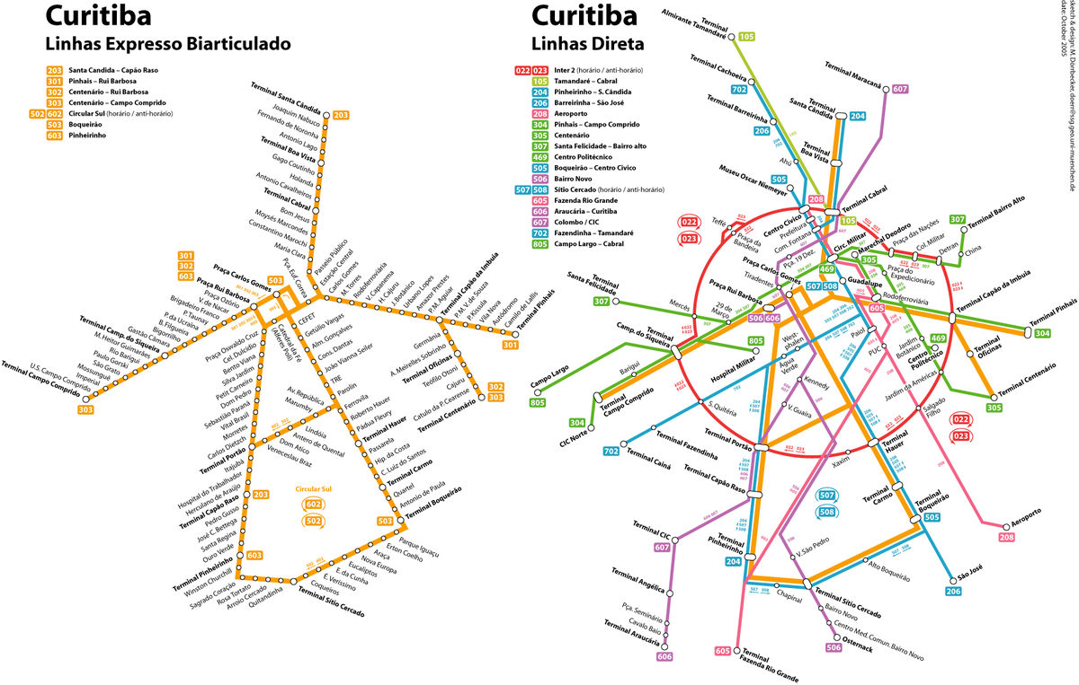
SUSTAINABLE TRANSIT CORRIDOR

Slide 9
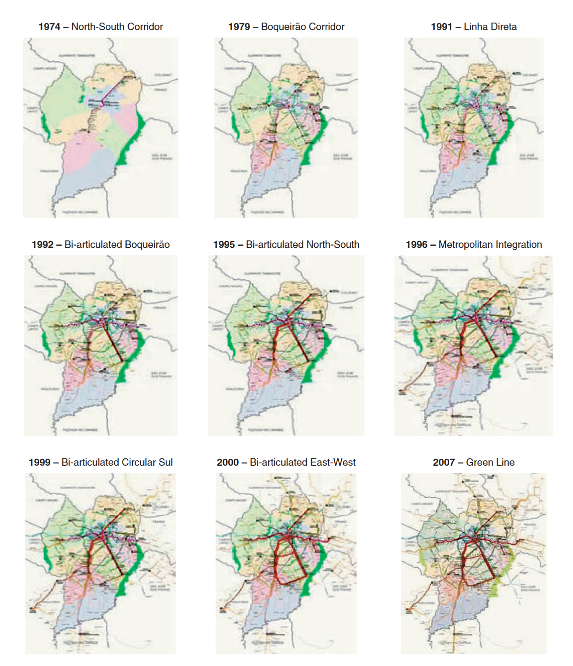
TRANSIT CORRIDOR HISTORICAL DEVELOPMENT

Slide 10
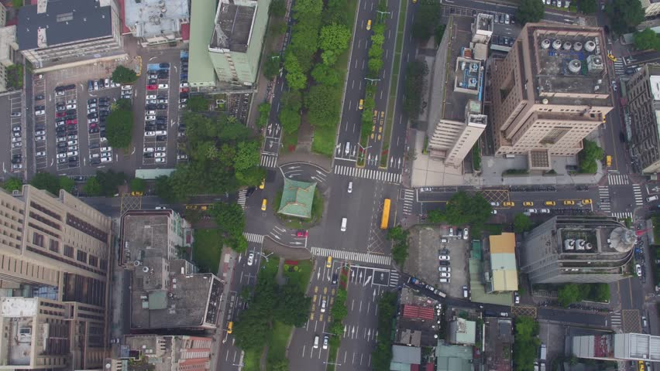
TRANSIT ORIENTED STREET DESIGN

Slide 11
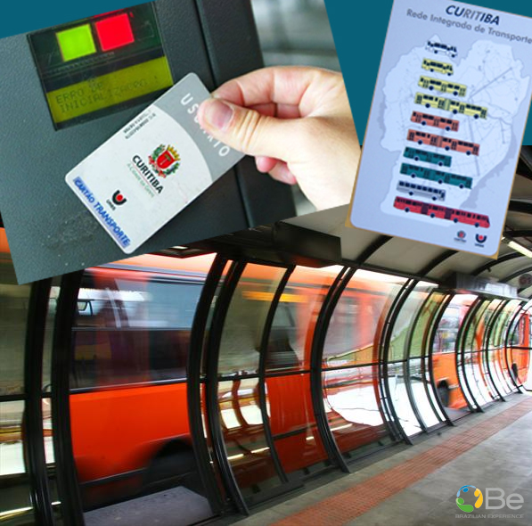
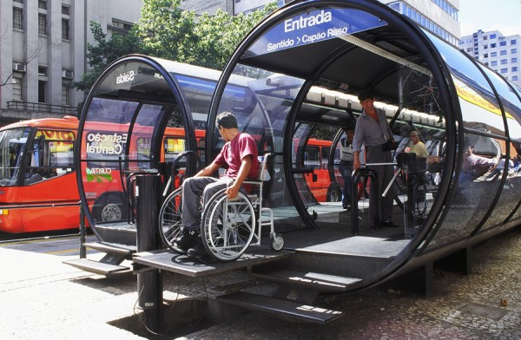
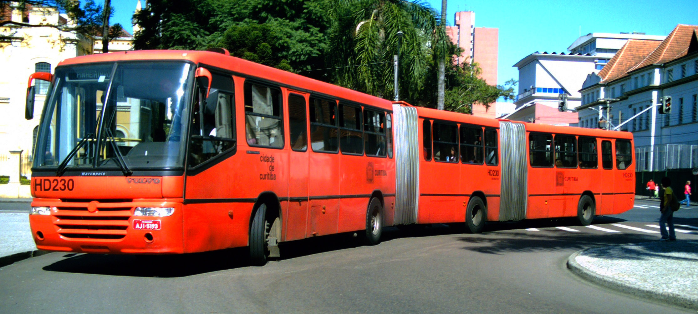
TRANSIT INFRASTRUCTURE

Slide 12
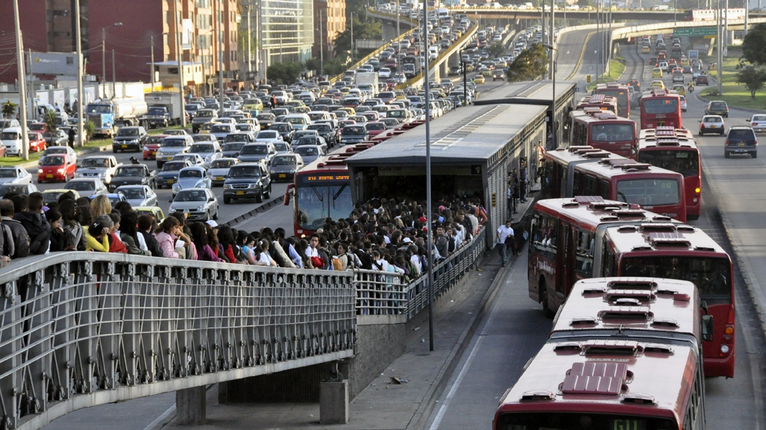

Slide 13

SYSTEM IMPROVEMENTS
Reduce crowding through introduction of “rush hour” specific routes
Improve quality of service through introduction of real-time displays and online routing
Improve system efficiency through centralized, system-wide control

Slide 14
BUS RAPID TRANSIT: CURITIBA, BRAZIL
Luis Antonio Lindau, Dario Hidalgo, Daniela Facchini
READING PRESENTATION: TEDDY KIM

